Slide 1
The SIMSSA Project: Search as access to digital music libraries
Emily Hopkins
SIMSSA Project Manager, McGill University
Workshop on SIMSSA XV, IAML, Leipzig, 28 July 2018

Slide 2
SSHRC Partnership Grant (2014-2021)
PI: Ichiro Fujinaga (McGill University)
Partners include the British Library, Bodleian Libraries at Oxford, Bibliothèque Nationale de France, Bavarian State Library, New York Philharmonic Archives, Alexander Street Press, RILM, and RISM Switzerland among others
Notes:
PARTNER LIST -- Include all partners who will be at IAML!

Slide 3
How it works:
Library digitizes scores
Optical Music Recognition
Symbolic Encoding with MEI
Search and Analysis

Slide 4
How do we access the scores?
How can we teach computers to read musical scores?
How will music search and analysis work?

Slide 5
How do we access the scores?

Slide 6
International Image Interoperability Framework

Slide 7
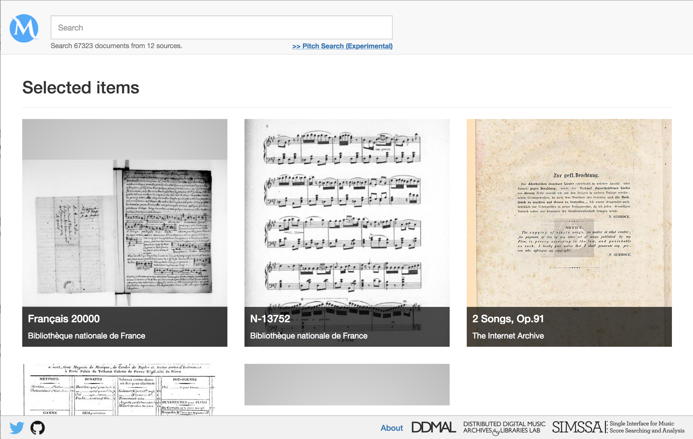
MusicLibs.net
Notes:
Music libs
Front page randomly serves up previews of scores in our database

Slide 8
How can we teach computers to read musical scores?

Slide 9
Optical Character Recognition
Makes images of text machine-readable
XML

Slide 10
Optical Music Recognition
Makes images of sheet music machine-readable
MIDI, MusicXML, MEI

Slide 11
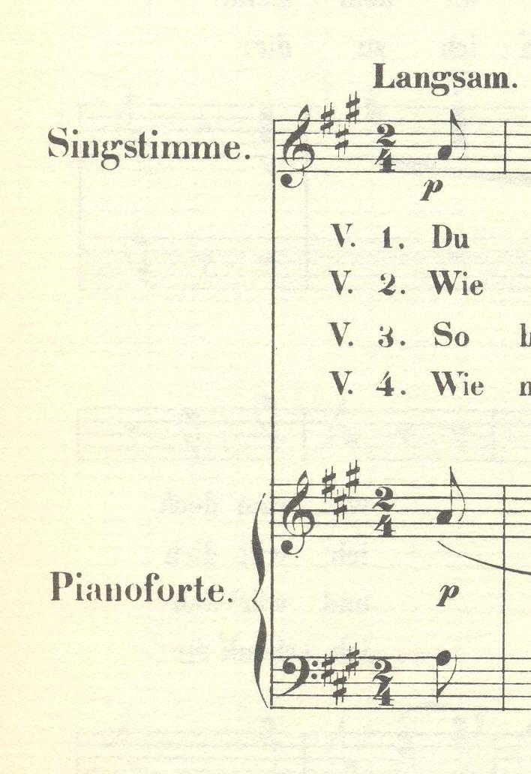
Music Encoding Initiative (MEI)
<music> <body> <mdiv> <score> <scoreDef meter.count="2" meter.unit="4" key.sig="3s"> <staffGrp symbol="line"> <staffDef n="1" label="Singstimme." lines="5" clef.shape="G" clef.line="2"/> <staffGrp symbol="brace" label="Pianoforte."> <staffDef n="2" lines="5" clef.shape="G" clef.line="2"/> <staffDef n="3" lines="5" clef.shape="F" clef.line="4"/> </staffGrp> </staffGrp> </scoreDef> </score> </mdiv> </body> </music>
Example borrowed from the MEI tutorial at music-encoding.org; music is Robert Schumann’s Der Abendstern.

Slide 12
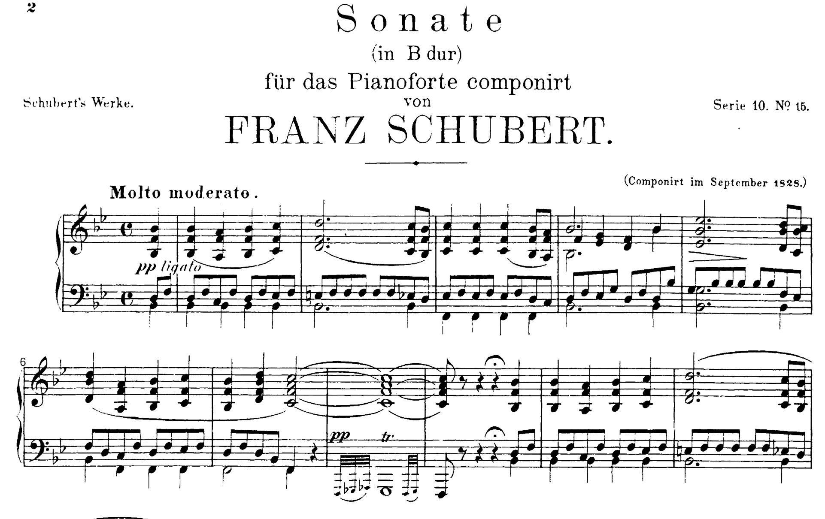
Commercial OMR

Slide 13
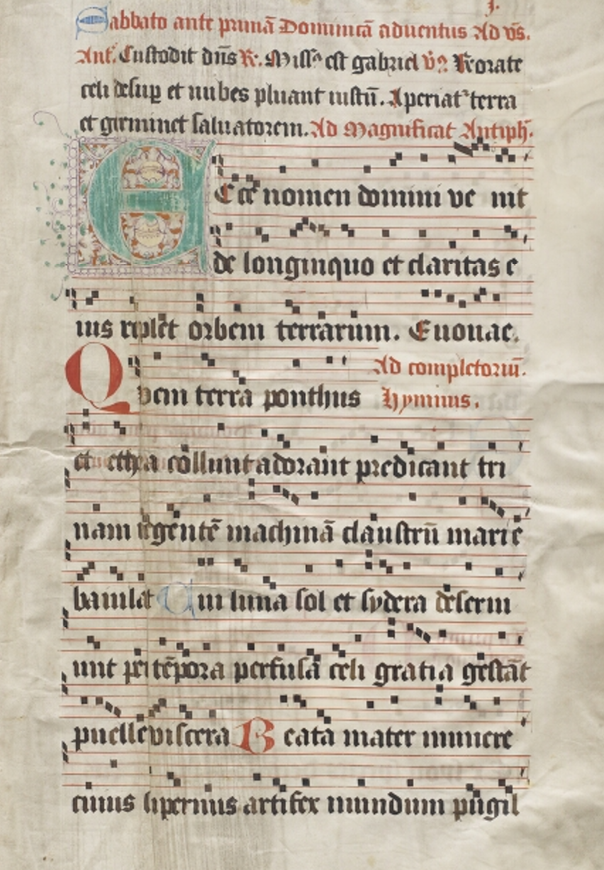
Salzinnes Antiphonal
CDN Hsmu M2149.L4
http://cantus.simssa.ca
Notes:
Whatever ground truth we give it!

Slide 14
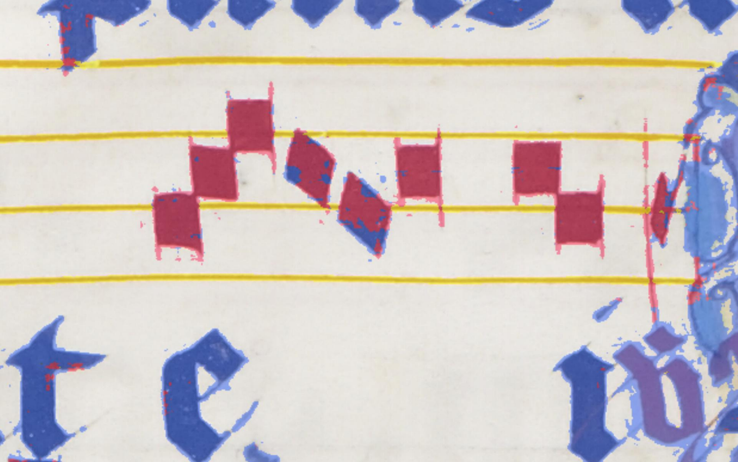
Pixel.js: Making ground truth data

Slide 15
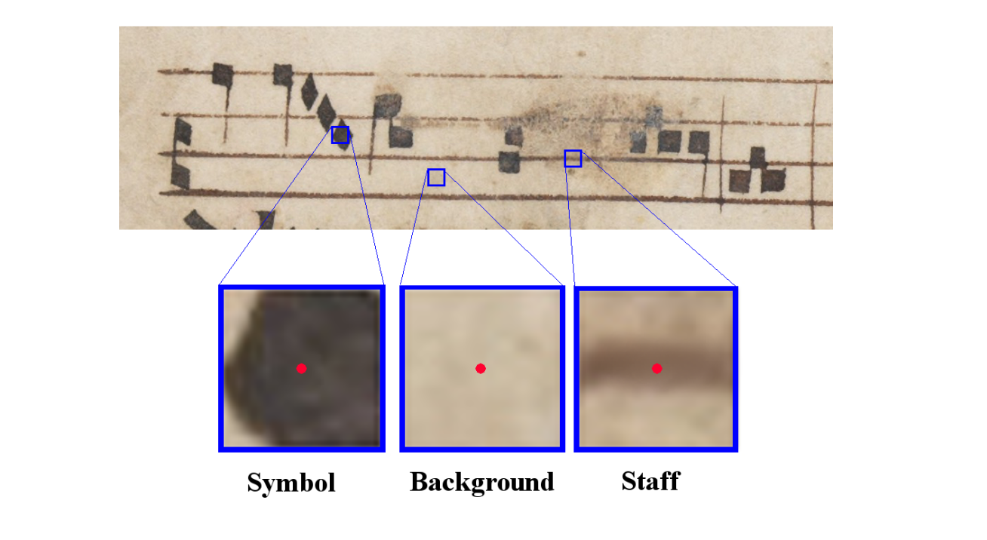
Pixelwise Classification
Calvo-Zaragoza, Jorge. “Pixelwise classification for music document analysis.” Presented at the Workshop on SIMSSA XII, August 7, 2017.

Slide 16
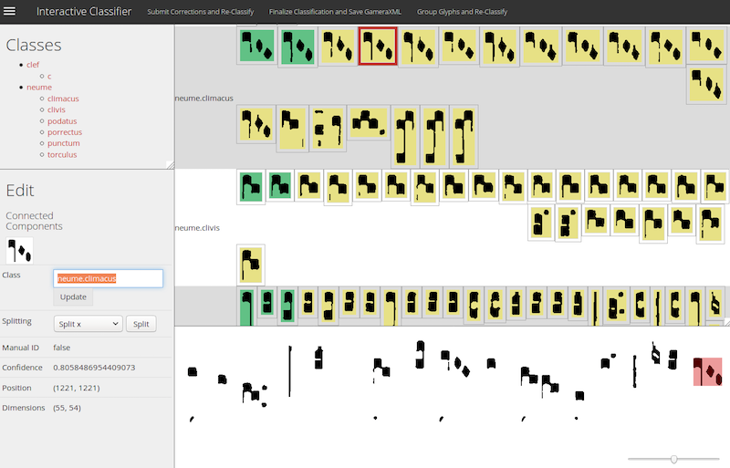
Interactive Classifier: Identifying glyphs & training our OMR

Slide 17
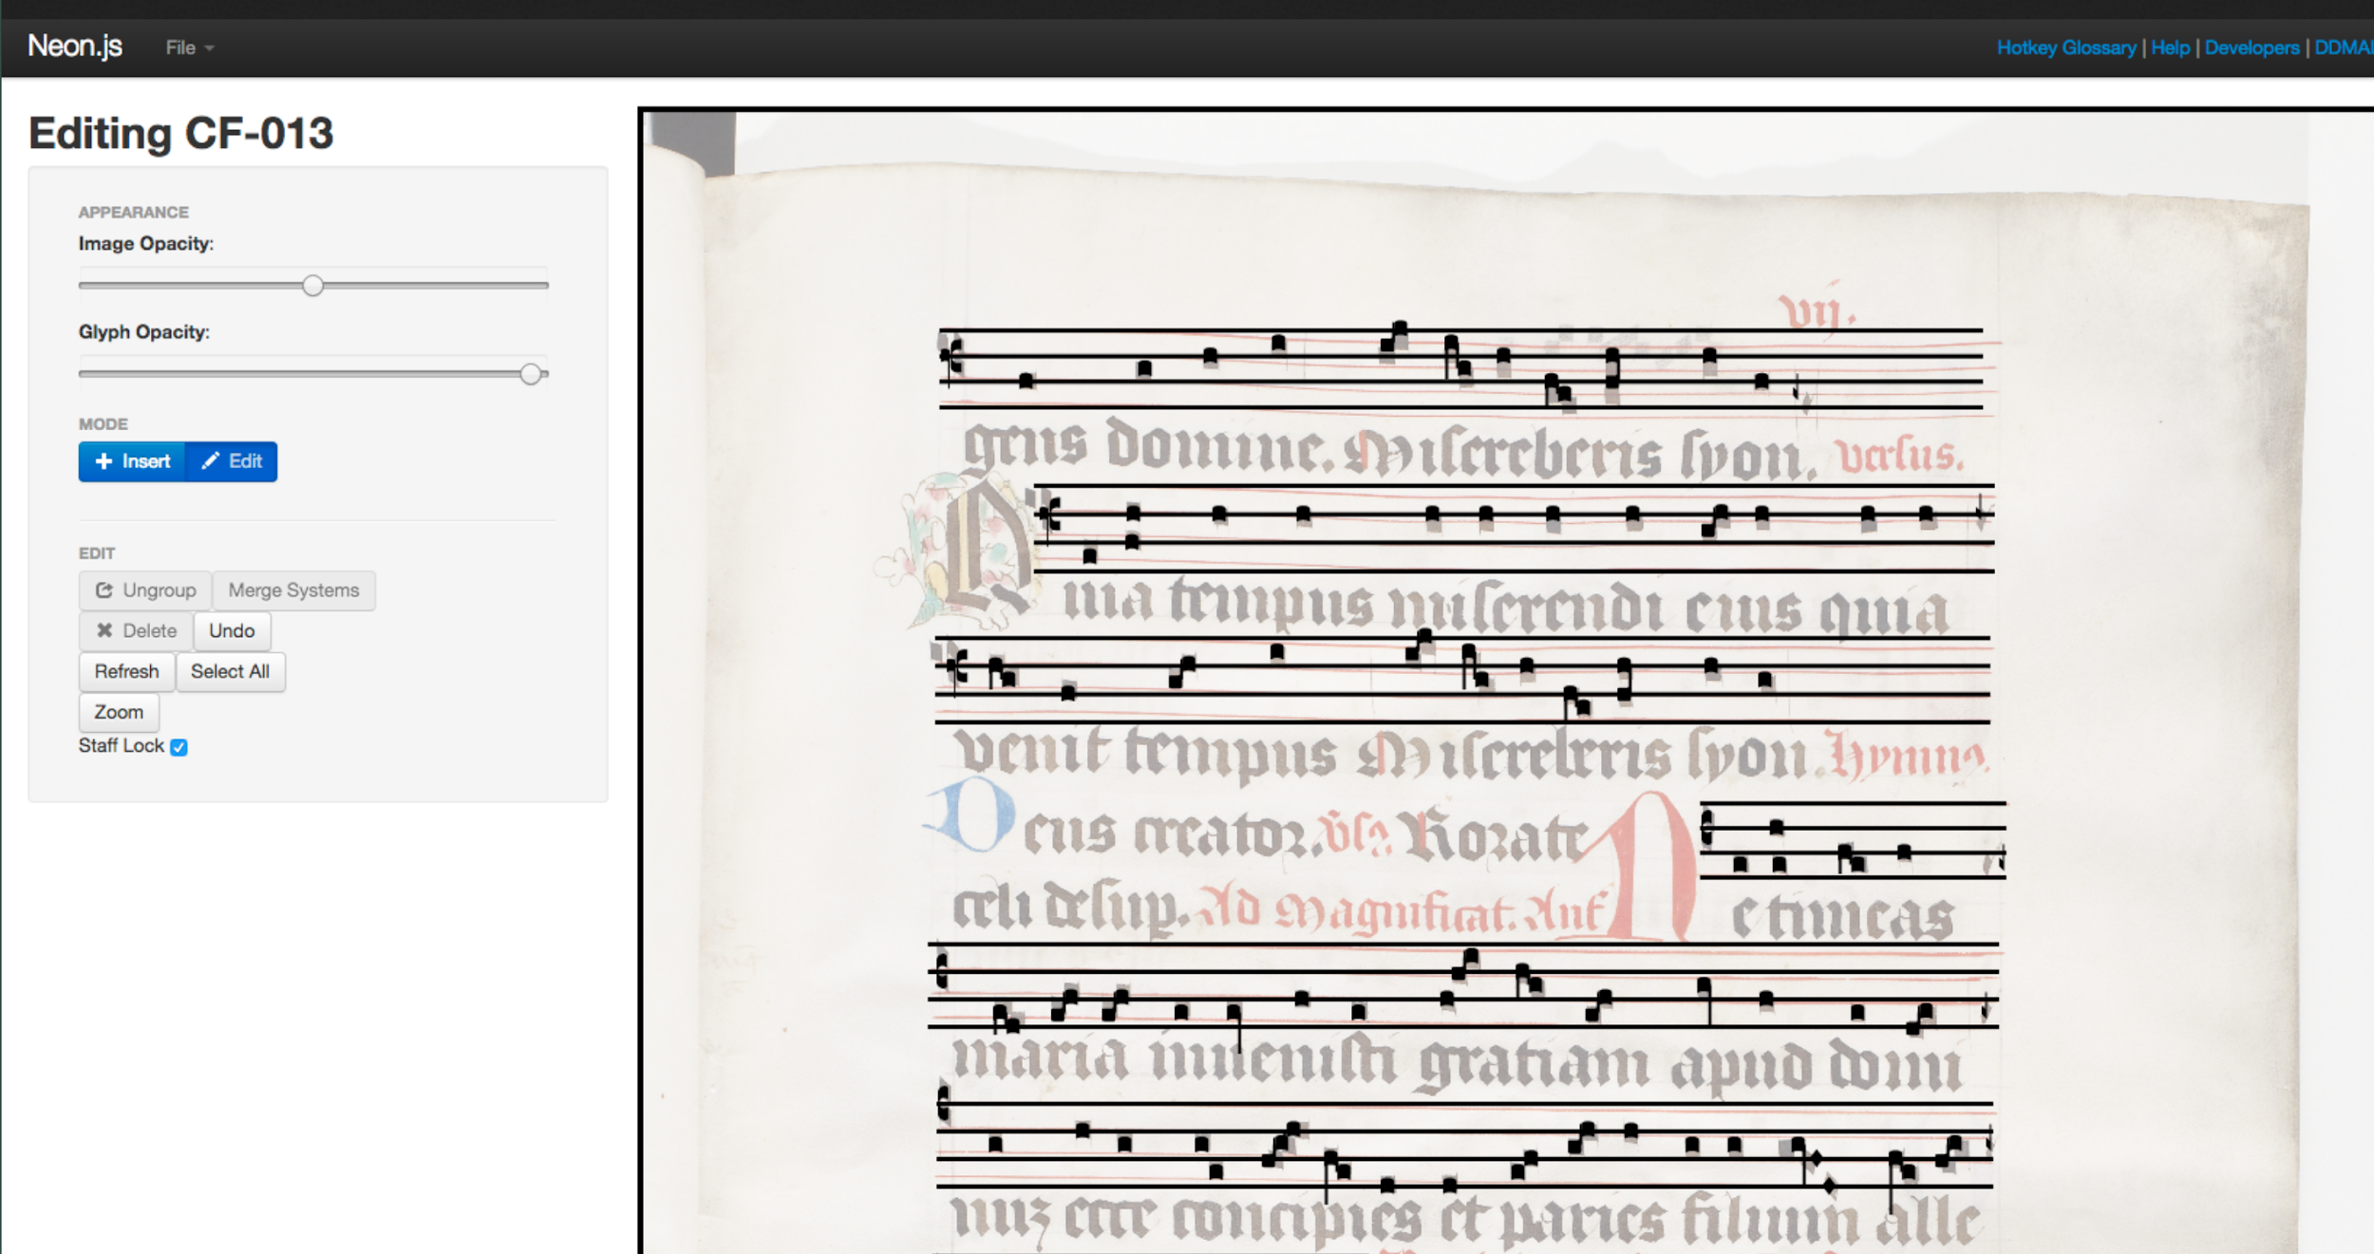
Neon.js: Correcting OMR output

Slide 18
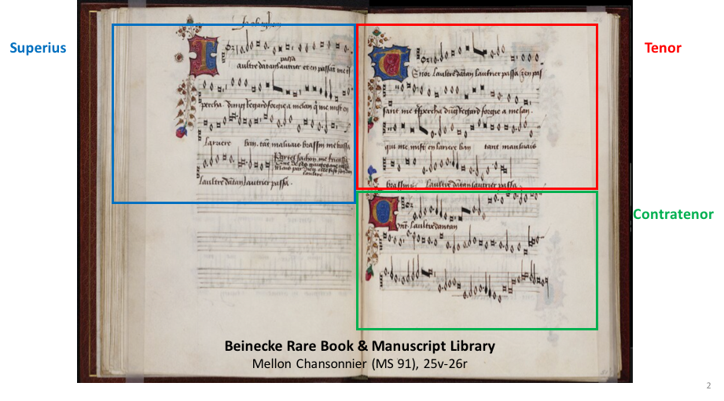
Scoring-up Tool
Slide courtesy of Thomae Elias, Martha Eladia, Julie Cumming, and Ichiro Fujinaga. “Automatic Scoring up of Music in Mensural Notation.” Presented at the 46th Medieval and Renaissance Music Conference, Maynooth, Ireland, July 2018.

Slide 19
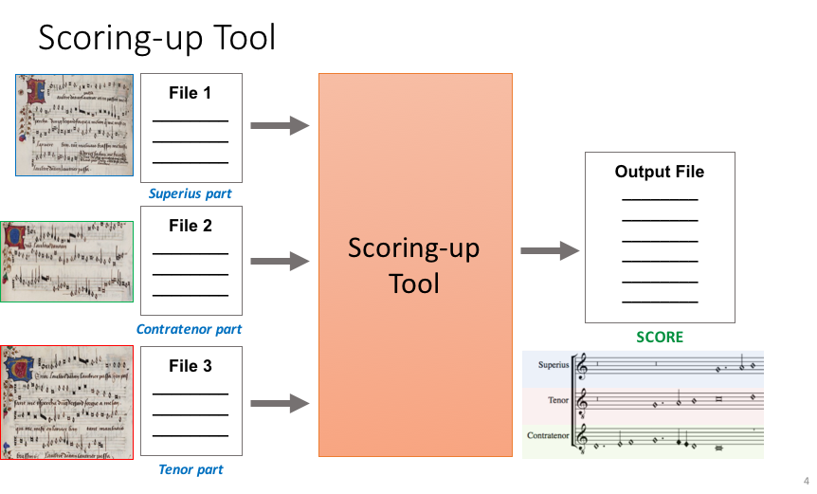
Slide courtesy of Thomae Elias, Martha Eladia, Julie Cumming, and Ichiro Fujinaga. “Automatic Scoring up of Music in Mensural Notation.” Presented at the 46th Medieval and Renaissance Music Conference, Maynooth, Ireland, July 2018.
Notes:
Encoding rules for context-dependent mensural notation
Relate to Measuring Polyphony

Slide 20
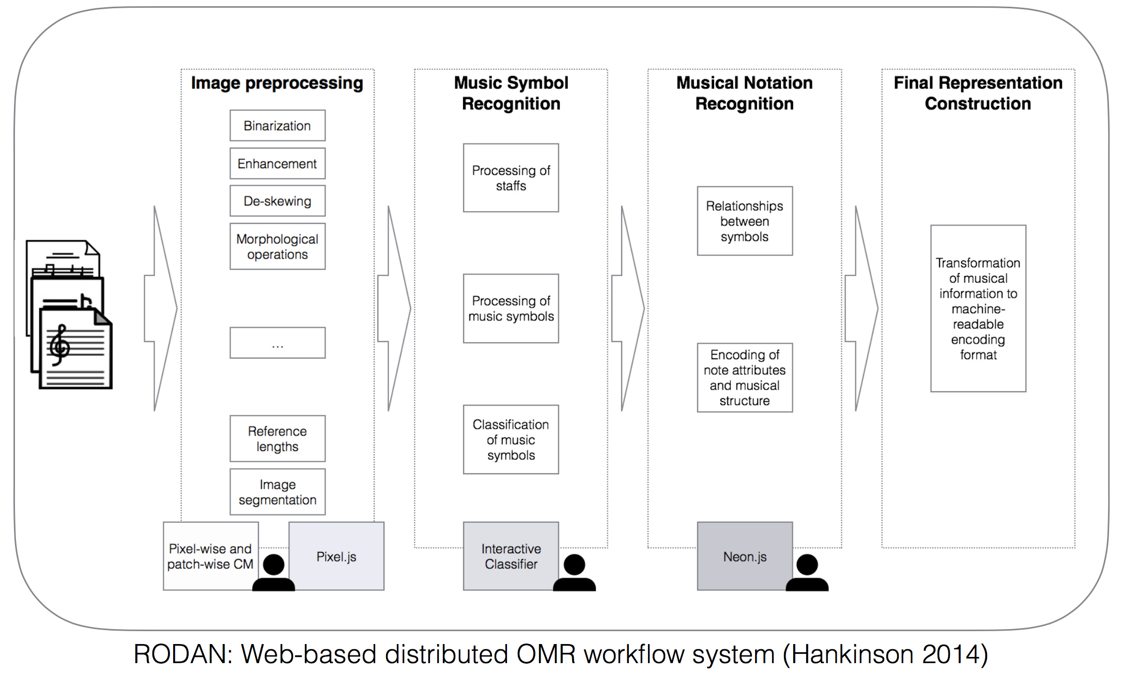

Slide 21
Crowdsourced OMR Correction
Making tools more user-friendly
Collaboration with Partner organizations and user communities

Slide 22
How will music search and analysis work?

Slide 23
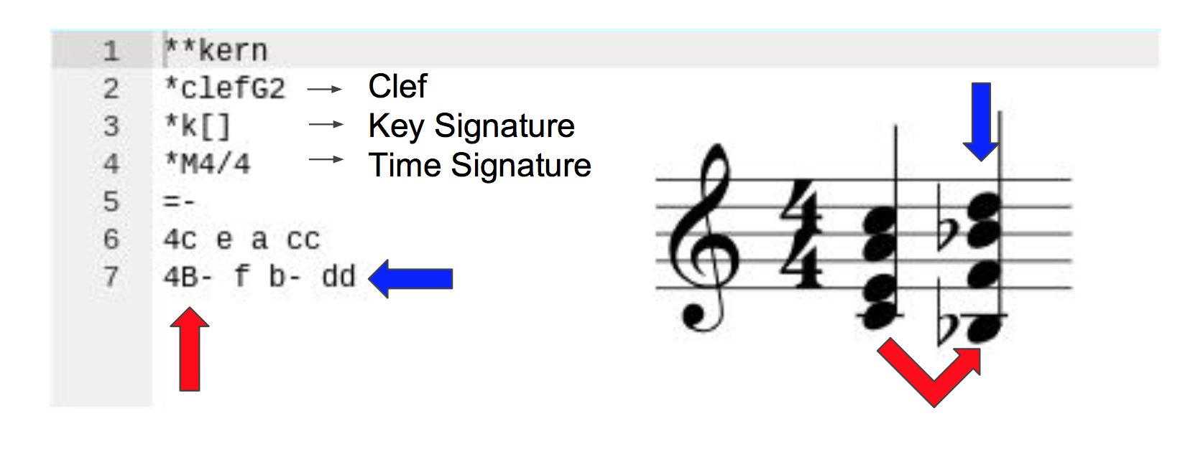
Melodic Search
Garfinkle, David & Peter Schubert. “Computer-Assisted Corpus Analysis Finds a Signature Progression in Willaert and Palestrina.” Presented at the 46th Medieval and Renaissance Music Conference, Maynooth, Ireland, July 2018.

Slide 24
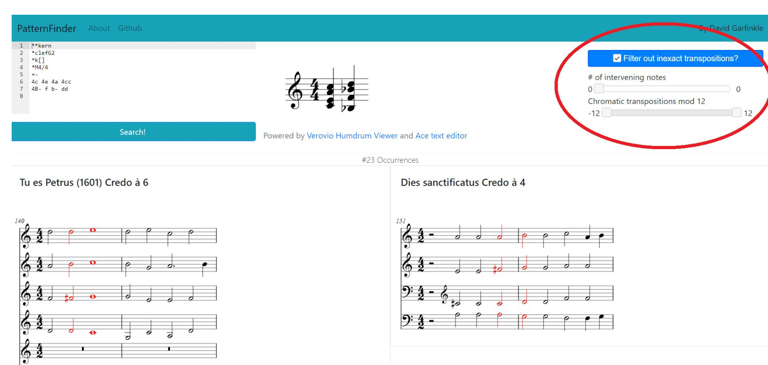
https://patternfinder.elvisproject.ca/

Slide 25
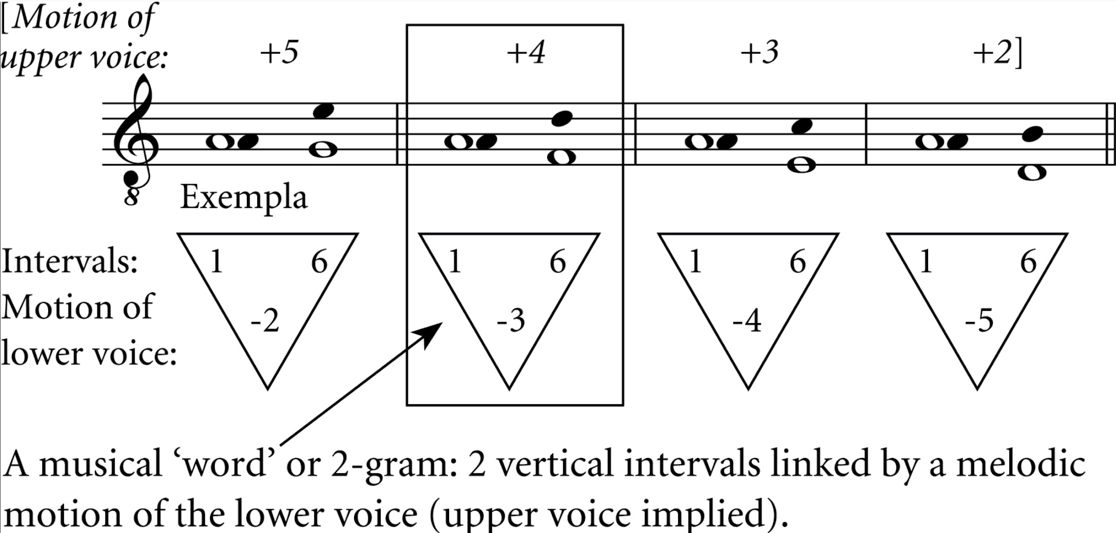
Corpus Studies
Schubert, Peter, and Julie Cumming. “Another Lesson from Lassus: Using Computers to Analyse Counterpoint.” Early Music 43, no. 4 (November 2015): 577–86.

Slide 26
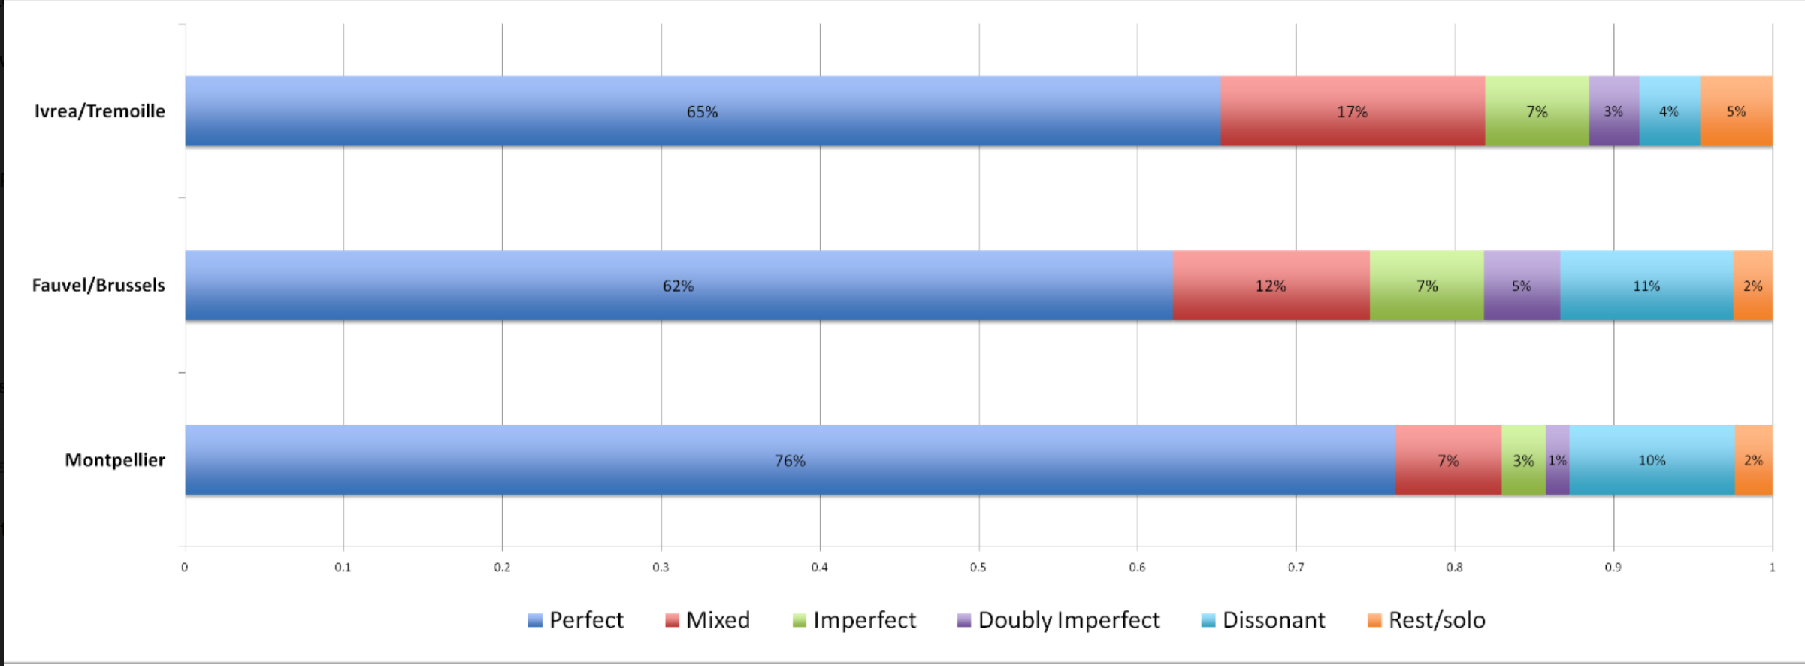
Desmond, Karen, Emily Hopkins, and Sam Howes. “Measuring Polyphony: Analysing Stylistic Change in the French Motet Repertory, C1300-1350.” Presented at the Workshop on SIMSSA VIII, McGill University, Montreal, QC, May 21, 2016.
Notes:
Comparing downbeats (only) to offbeats (only)

Slide 27
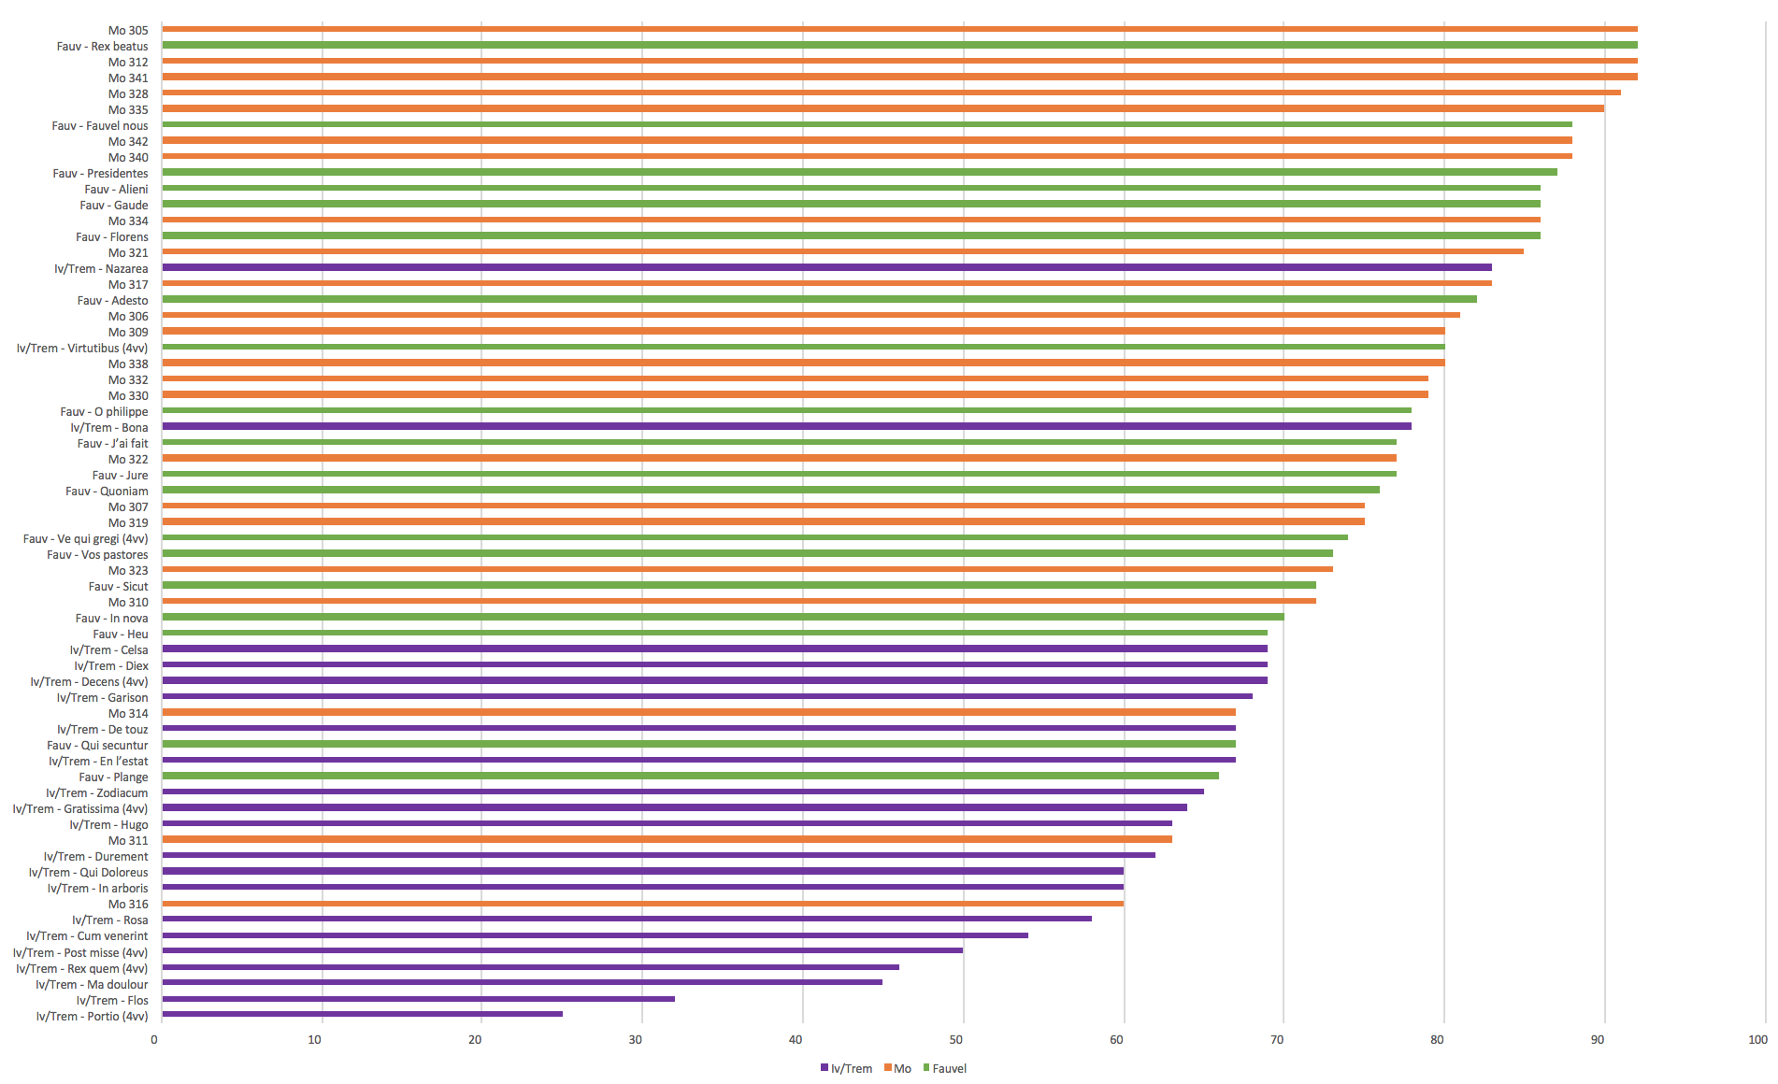
Percentage of perfect sonorities for all pieces

Slide 28
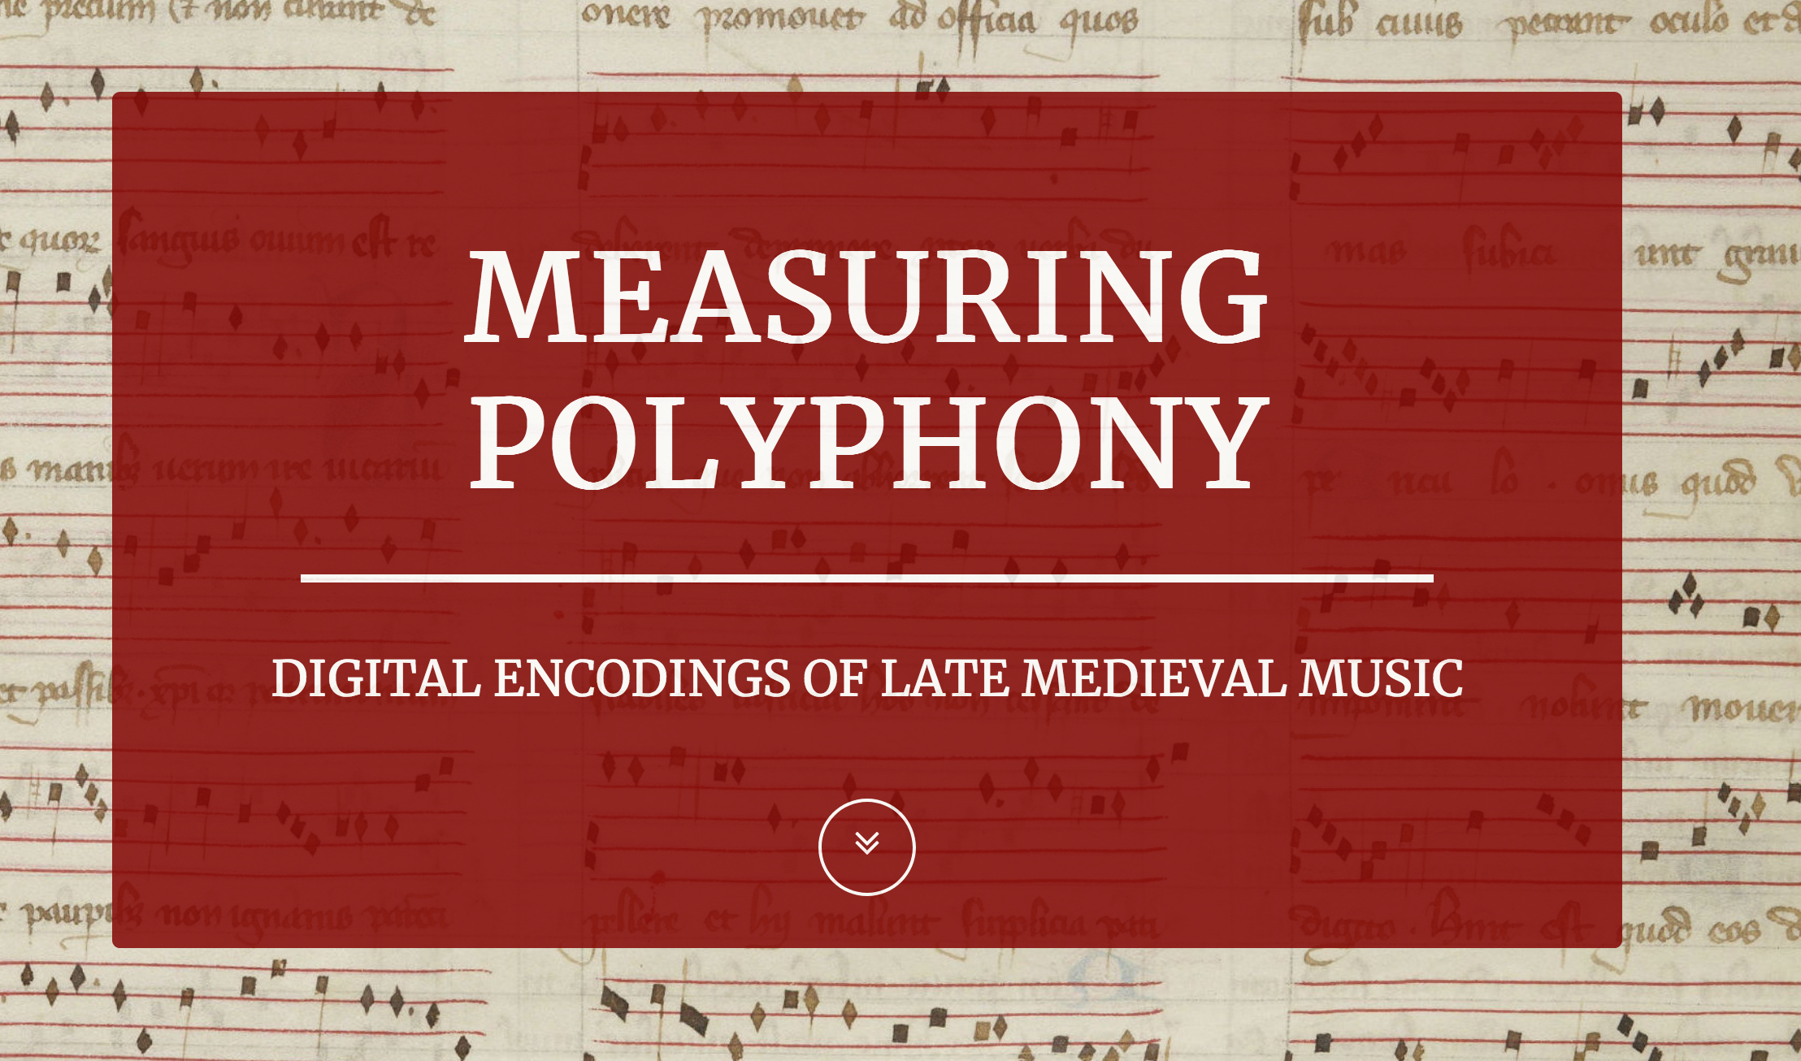
http://measuringpolyphony.org/

Slide 29
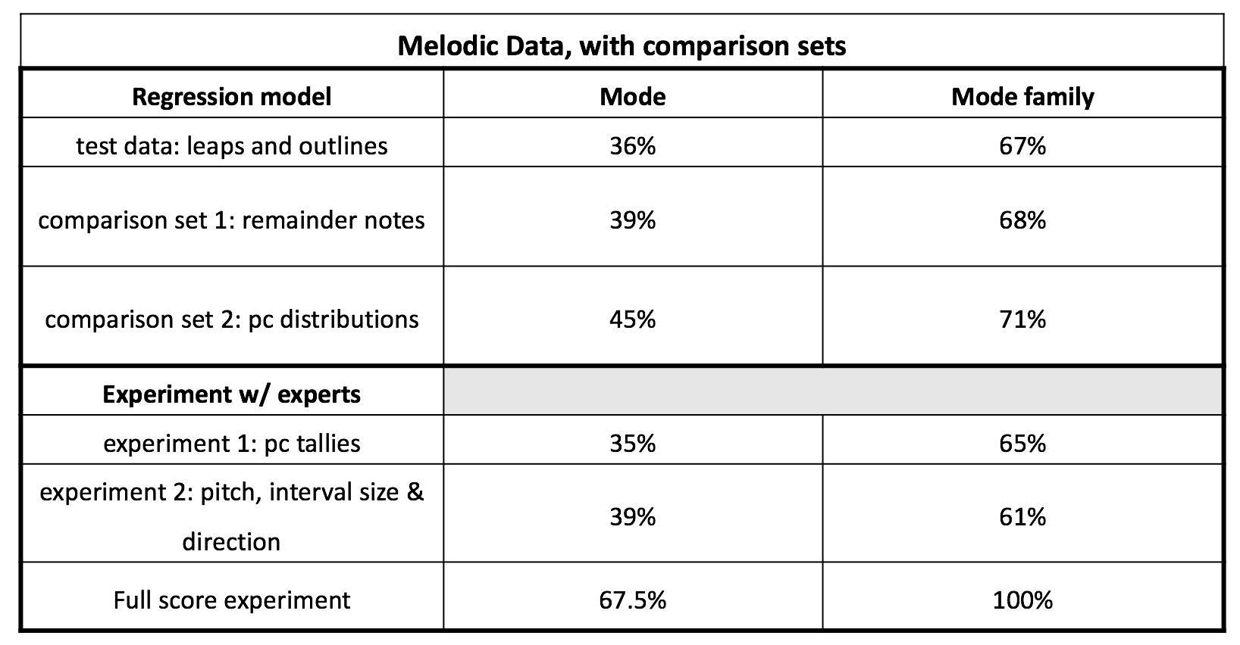
Arthur, Claire, Julie Cumming, and Peter Schubert. “Computer-Assisted Modal Identification.” Presented at the 46th Medieval and Renaissance Music Conference, Maynooth, Ireland, July 2018.

Slide 30
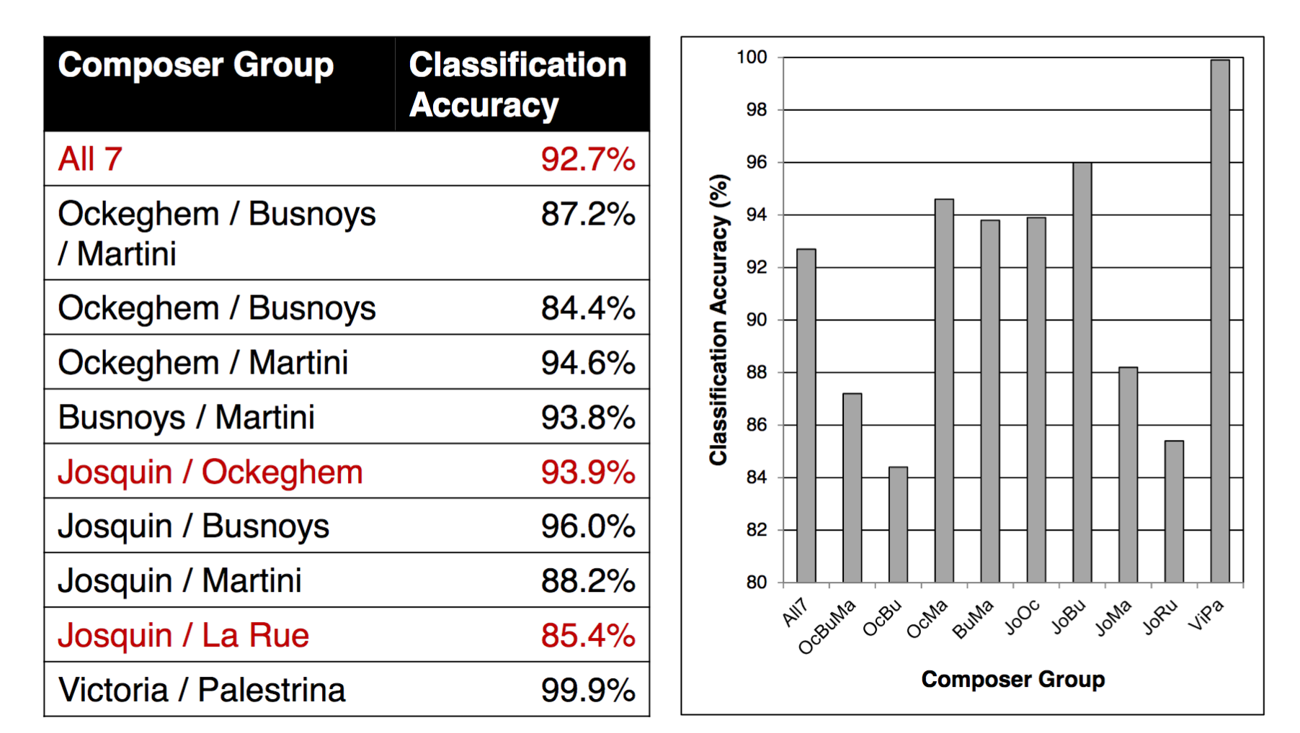
Machine learning and composer identification
McKay, Cory, Tristano Tenaglia, Julie Cumming, and Ichiro Fujinaga. “Using Statistical Feature Extraction to Distinguish the Styles of Different Composers.” Presented at the Medieval and Renaissance Music Conference, Prague, Czech Republic, July 4, 2017.

Slide 31
Thank you!
https://simssa.ca/ emily.hopkins@mcgill.ca
@simssaproject
@e_a_hopkins

Slide 32
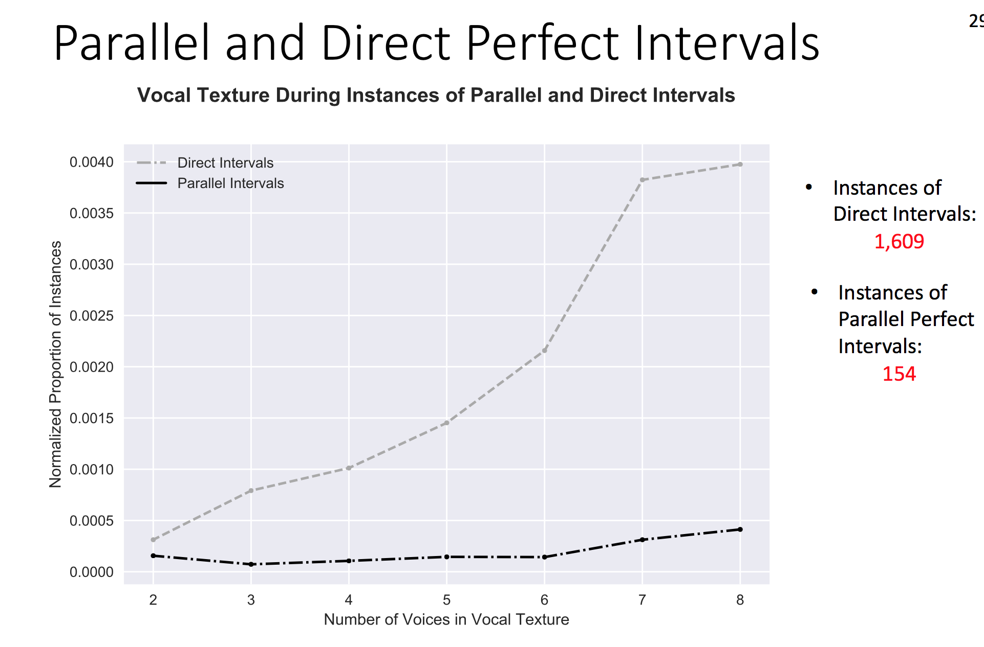
Arthur, Claire. “Renaissance Counterpoint in Theory and Practise: A Case Study.” Presented at the 45th Medieval and Renaissance Music Conference, Prague, Czech Republic, July 4, 2017.

Slide 33
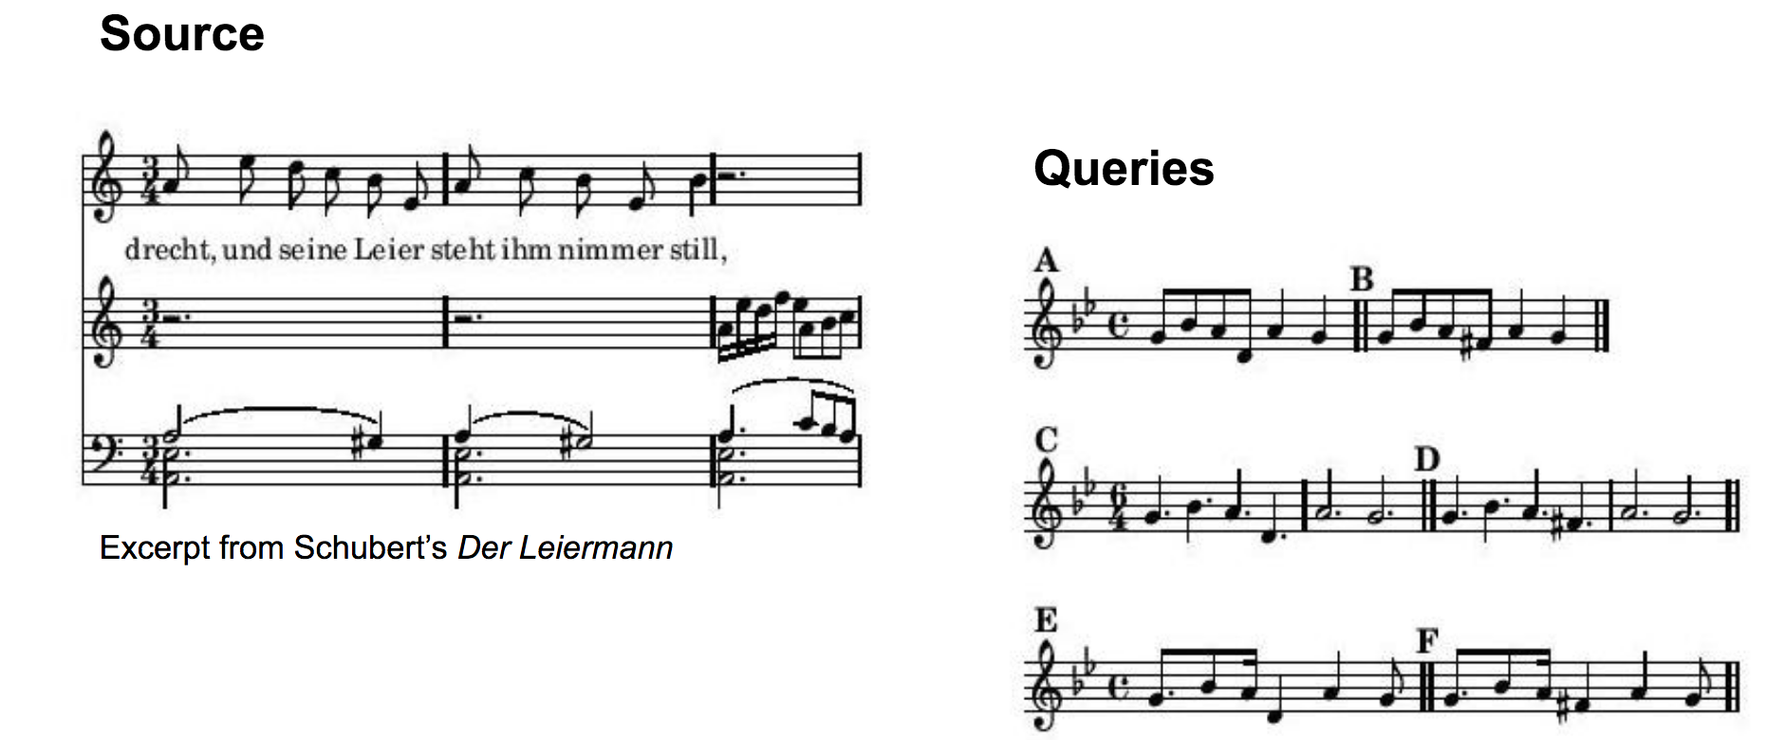
Melodic Search
Garfinkle, David. “PatternFinder: Content-based music retrieval with music21” Presented at the Workshop on SIMSSa XII, August 7, 2017.

